Slide 1
Name: Swapnil Ghosh
Group: A2
Roll: 001911001067
TASK 19

Slide 2
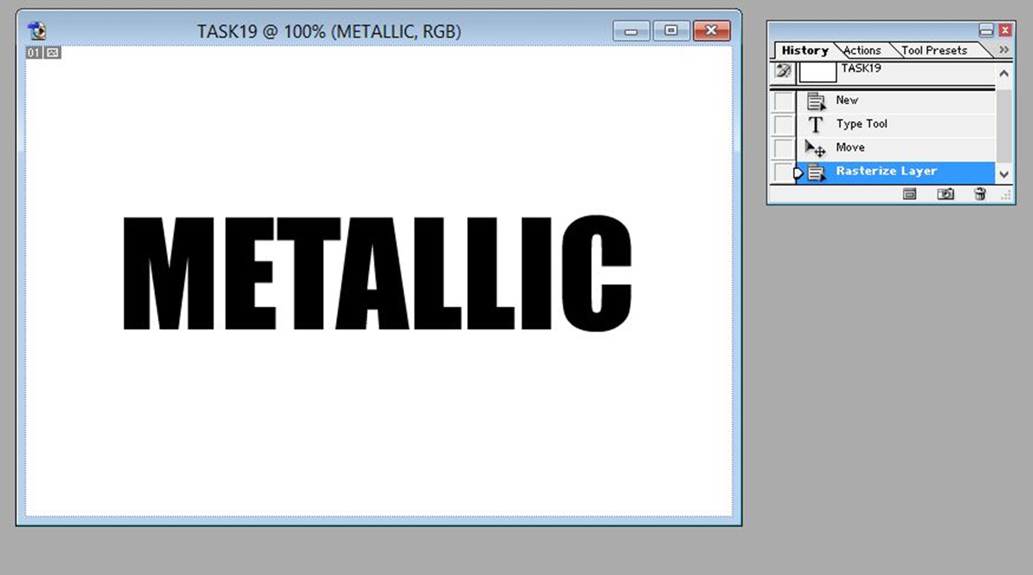
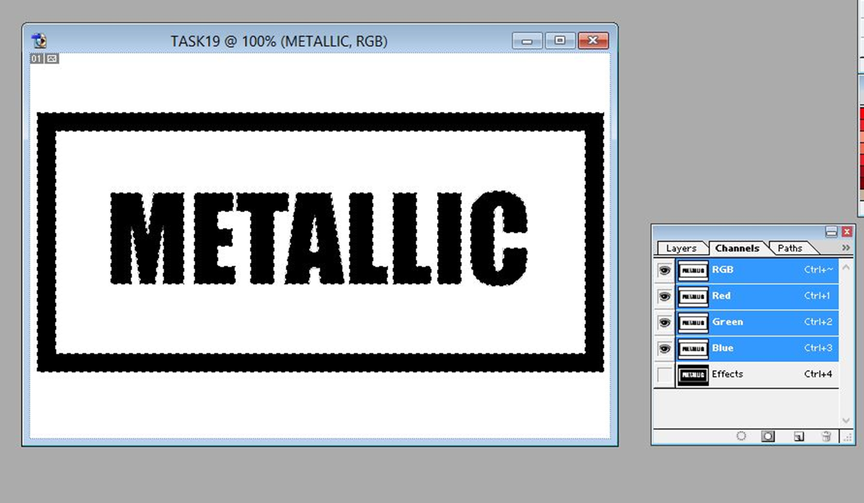
Step-1) Created a new file having dimensions 600 by 400 with white background. Set FG color to black.
Step- 2) Wrote the word METALLIC using font Impact, size 120, color black and positioned the text at center of image.
Step- 4) Choose the Layer > Rasterize > Type, to rasterize the text layer.
Step- 5) Draw a border around text using Rectangular Marquee and choose Edit > Stroke, 20 px, inside
Step- 6) Pressing CTRL click on the Metallic layer to load selection. Choose the Select > Save Selection tocreate an Alpha channel in Channels palette. Named the channel as Effects.
Step-7) In Channels palette select Effects. Choose Filter > Blur > Gaussian Blur with radius 2 px.
Step- 8) In Layers palette create a new layer above Metallic layer, and fill it with 50% gray using Edit > Fill. Call the layer Gray.
Step-9) With Gray selected, choose Filter > Render > Lighting Effects. In Texture Channel field choose Effects. In Preview panel drag light source to top-left and drag the middle anchors to encompass the entire image as shown. Rotate the light source slightly clockwise.

Slide 3
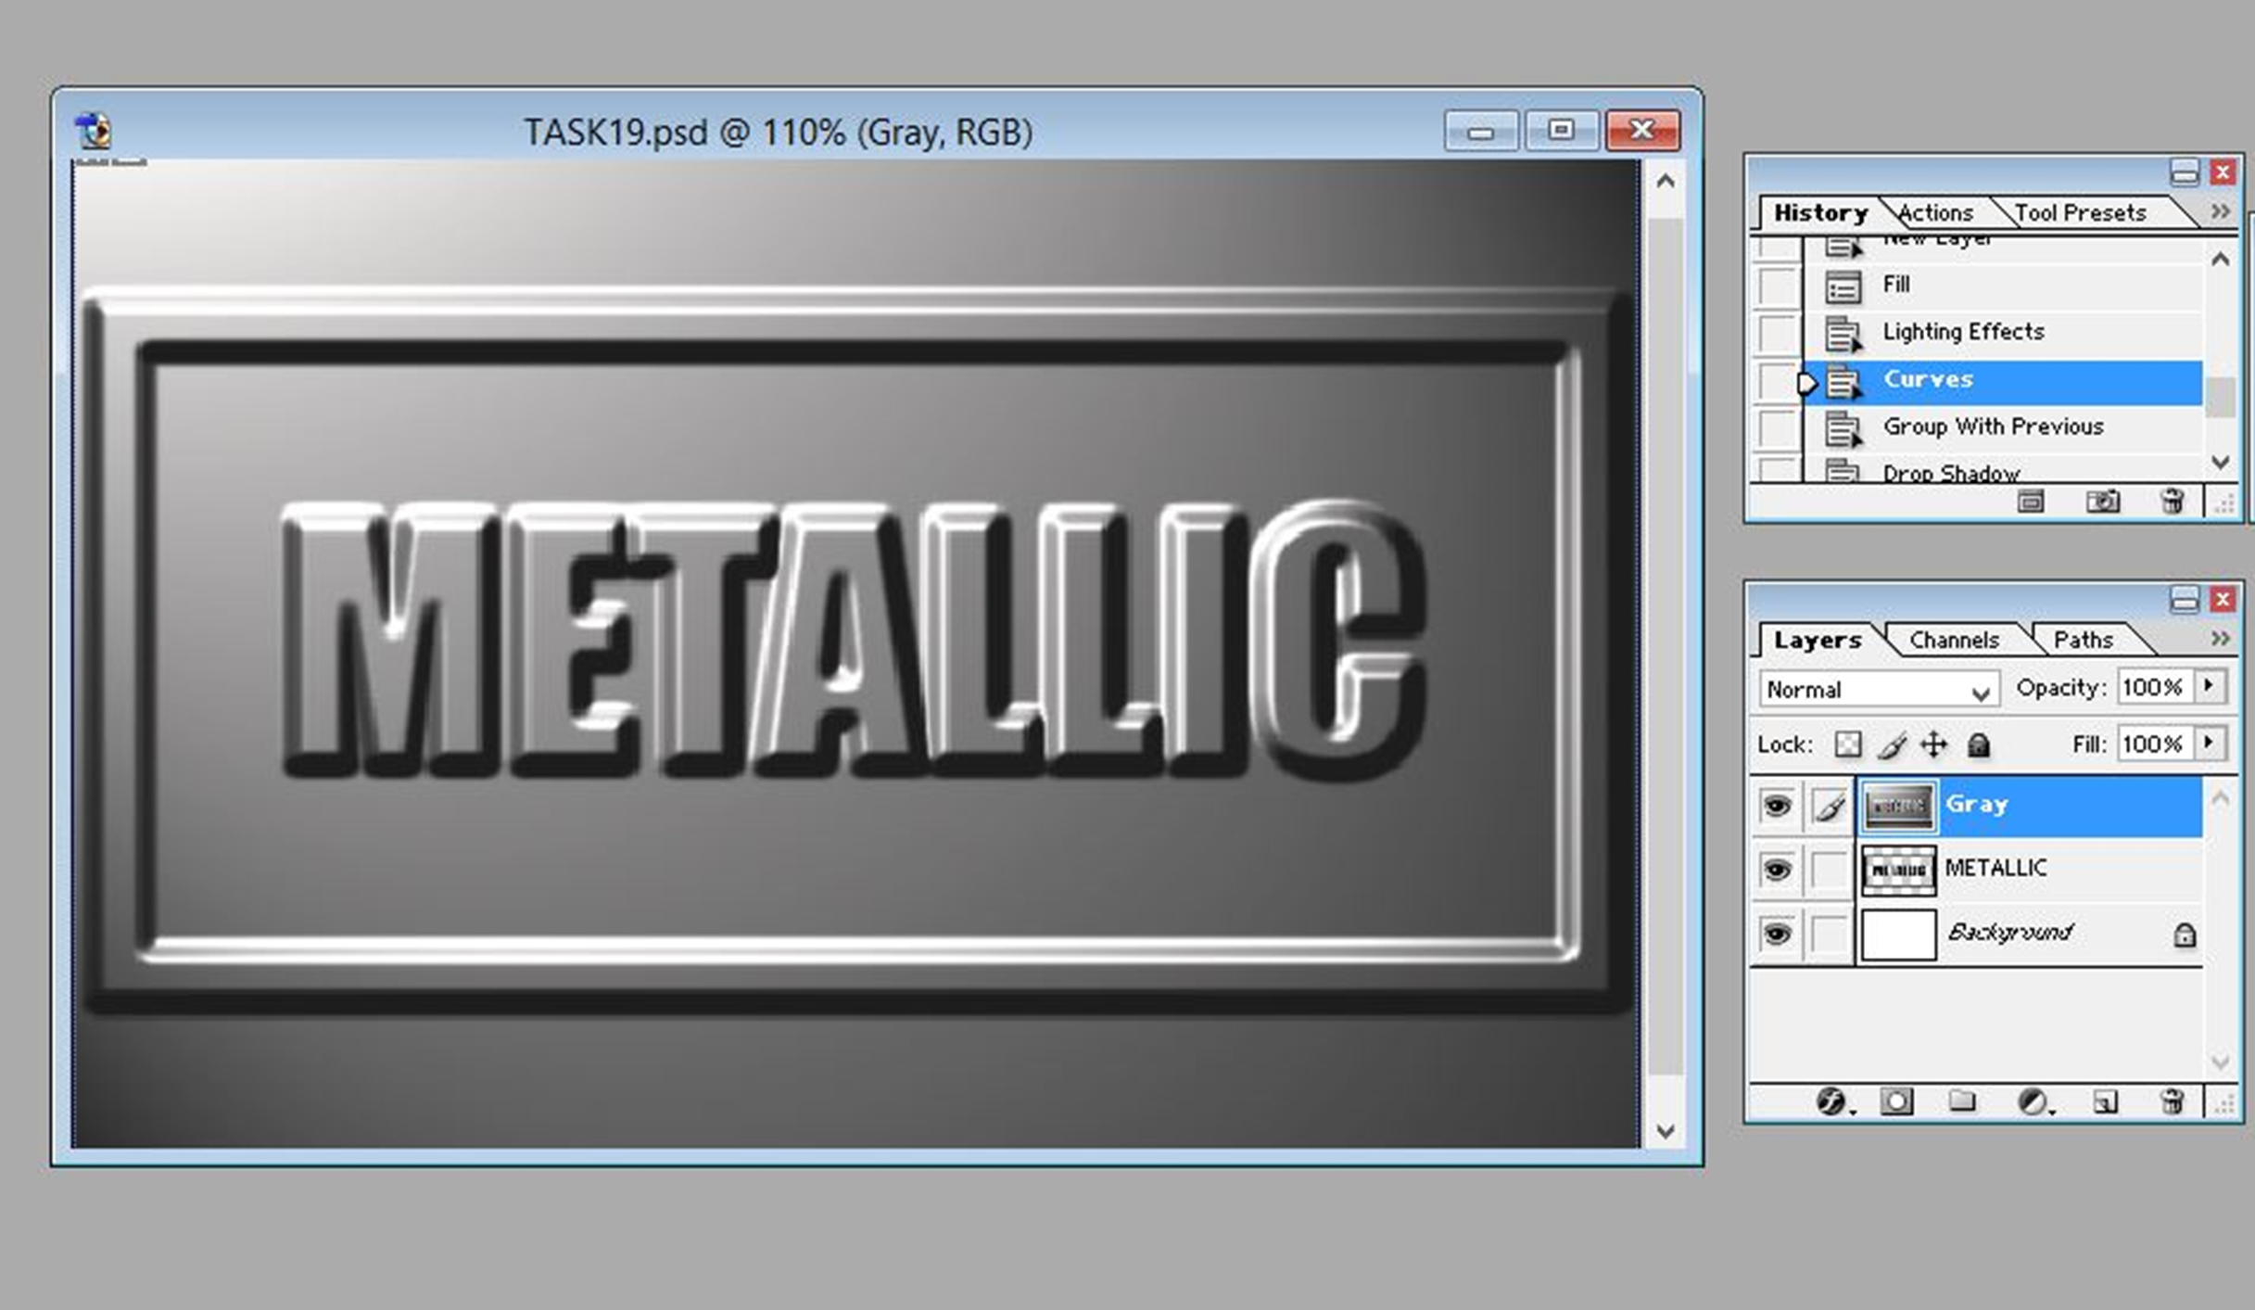
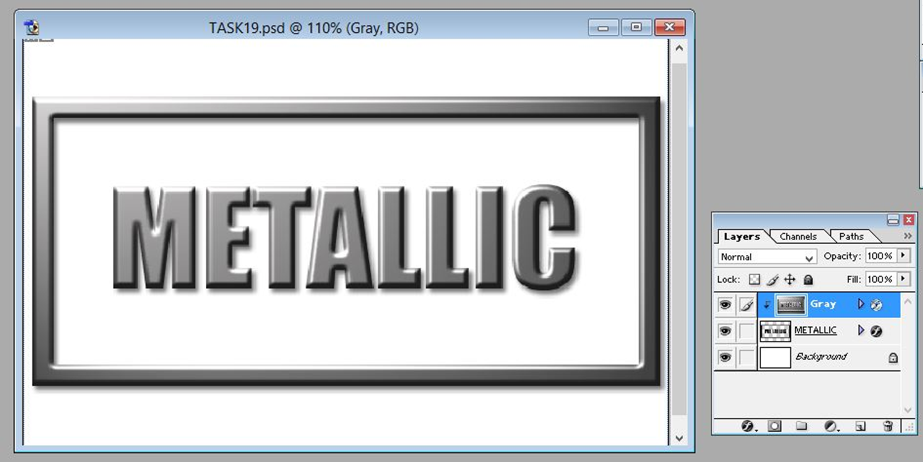

Step- 10) With Gray selected, chose the Image > Adjust > Curves and made the shape of the curve as shown.
Step- 11) With Gray selected, choose Layer > Group with Previous. The Gray layer is now masked out by the Metallic layer.
Step- 12) With Metallic selected choose Layer > Layer Style > Drop Shadow.

